Slide 1

HTML Basics
Hypertext Markup Language
SoftUni Team
Technical Trainers
Software University
http://softuni.bg

Slide 2
Table of Contents
What is HTML?
Element Anatomy
Document Anatomy
Formatting Text
Attributes
Images, Links and Forms
Multimedia Context
Nested Elements

Slide 3
Questions?
sli.do
#fund-common

Slide 4

HTML
Standard for Markup Language

Slide 5
What is HTML?
Standard markup language for creating and displaying web content
It represents a series of elements that you use to wrap different portions of content to make them look and act in a certain way
HTML is not a programming language - it is a markup language that is used to tell your browser how to display the pages you are visiting
It’s just a text file with .html extension
Notes:
HTML (Hypertext Markup Language) is the code used to build and display a web page and its content
Standard markup language for creating web content
It represents a series of elements that you use to surround (or wrap) different portions of content to make them look and act in a certain way
HTML is not a programming language - it is a markup language that is used to tell your browser how to display the pages you are visiting.
It’s just a text file with .html extension.

Slide 6

Anatomy of an Element

Slide 7
Element Anatomy
The main parts of an element are: Opening, Content and Closing tag
Opening tag - It consists of the name of the element surrounded by opening and closing angles
It indicates where the element starts
Character (Tag name)
Left angle bracket (Less than sign)
Right angle bracket (Greater-than sign)
<html>

Slide 8
Element Аnatomy
Closing tag - Same as the opening tag, but with an additional slash before the item's name
It shows where the element ends
Character (Tag name)
Left angle bracket (Less than sign)
Right angle bracket (Greater-than sign)
</html>
Forward slash (end tag indicator)

Slide 9
Element Anatomy
Everything between the opening and closing tags is defined as the content of this element
The element is the set of the opening tag, closing tag and content
<html> <!-- HTML ELEMENT CONTENT--> </html>
<p> Hello, HTML! </p>

Slide 10
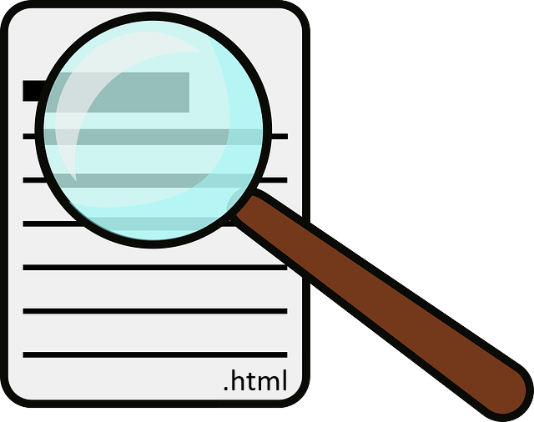
Document Anatomy

Slide 11
Document Anatomy
The basic requirement for content that a html file should have
<!DOCTYPE html> <html lang="en"> <head> <meta charset="UTF-8"> <title>HTML</title> </head> <body>
. . .
</body> </html>

Slide 12

<!DOCTYPE html>
Describes the HTML
It is an instruction for the web browser about what version of HTML the page is written in
The DOCTYPE is supported by all modern web browsers like: Chrome, Firefox, IE, Safari and Opera
<!DOCTYPE html>
. . .

Slide 13

The <html> tag
This element surrounds the entire content of the page
The html element must contain a head element followed by a body element
<!DOCTYPE html> <html> <head> . . . </head> <body> . . . </body> </html>

Slide 14
The <head> tag
Container for metadata
HTML metadata is data about the HTML document but is NOT displayed
Metadata typically define the document title, styles, links, scripts, and other meta information
<!DOCTYPE html> <html> <head> <!-- HEAD ELEMENT CONTENT--> </head> <body> . . .
</body> </html>
<head>

Slide 15
The <meta> tag
The information inside the <meta> tag is not displayed on the page but is relied on by the machine
Meta elements are usually used to add a description to the page, keywords or character sets
Meta tags are always in the <head> element
Notes:
The metadata is used by the browser to know how to load the page or reload it, from the search engines (keywords) or other web services.
<meta> tags are always in the <head> element.
Meta elements are usually used to add a description to the page, keywords or character sets.

Slide 16
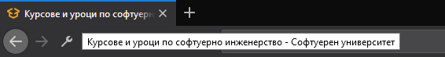
The <title> tag
Defines the title of the document
Defines the title in the browser's toolbar
Gives a page title when added to favorites
Shows the title of the page in the search engines
Title

Slide 17
The <body> tag
Defines the main content of the HTML document or the section of the HTML document that will be directly visible on your web page
<!DOCTYPE html> <html> <head> … </head> <body> <!-- BODY ELEMENT CONTENT--> </body> </html>
Notes:
Head is required and it should be used just once. It should start immediately after the opening html tag and end before the opening body tag.
<body> tag defines the main content of the HTML document or the section of the HTML document that will be directly visible on your web page.

Slide 18
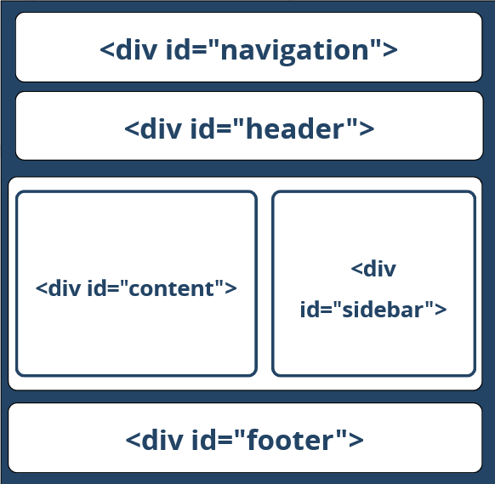
The "HTML4 & Old" Way
Using <div>s with IDs (the IDs are needed for styling)
<html>
<head> … </head>
<body>
<div id="navigation">…</div>
<div id="header">…</div>
<div id="sidebar">…</div>
<div id="content">…</div>
<div id="footer">…</div>
</body>
</html>

Slide 19
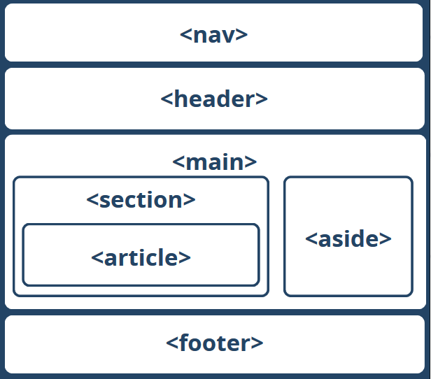
The HTML5 Way
HTML5 uses semantic tags for the document structure
<body>
<nav>…</nav>
<header>…</header>
<main>
<aside>…</aside>
<section>
<article>…</article>
</section>
</main>
<footer>…</footer>
</body>

Slide 20

Formatting Тext

Slide 21
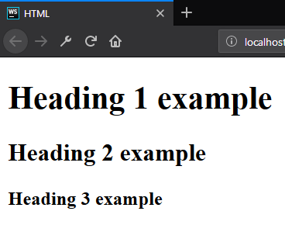
Formatting Text - Heading
Allows you to specify that certain portions of the content are titles or subheadings
<body> <h1>Heading 1 example</h1> <h2>Heading 2 example</h2> <h3>Heading 3 example</h3> </body>

Slide 22
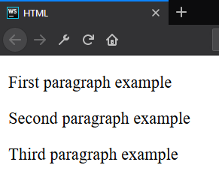
Formatting Text - Paragraph
Is meant to contain the individual paragraphs in the text
<body> <p>First paragraph example</p> <p>Second paragraph example</p> <p>Third paragraph example</p> </body>

Slide 23
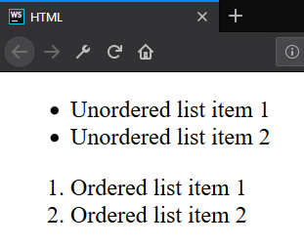
Formatting Text - List
The lists contain at least two elements
The most common types are ordered and unordered lists
<ul> <li>Unordered list item 1</li> <li>Unordered list item 2</li> </ul> <ol> <li>Ordered list item 1</li> <li>Ordered list item 2</li> </ol>

Slide 24
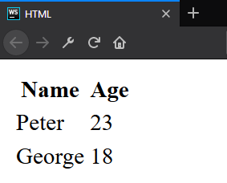
Formatting Text - Table
A structured set of data made up of rows and columns
<table> <thead> <tr><th>Name</th><th>Age</th></tr> </thead> <tbody> <tr><td>Peter</td><td>23</td></tr> <tr><td>George</td><td>18</td></tr> </tbody> </table>

Slide 25
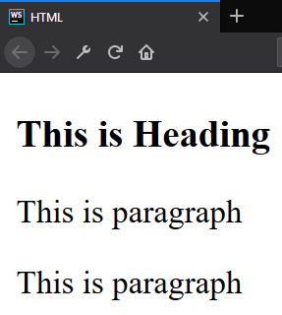
Formatting Text - Division Element
Division element (div) is the generic container for flow content
It has no effect on the content or layout
As a "pure" container, the <div> element does not inherently represent anything
<div> <h3>This is Heading</h3> <p>This is paragraph</p> <p>This is paragraph</p> </div>

Slide 26
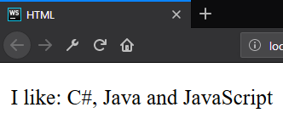
Formatting Text - Span
Span element is a generic inline container for phrasing content, which does not inherently represent anything
It can be used to group elements for styling purposes
<p> I like: <span>C#, Java and JavaScript</span> </p>

Slide 27
id?
class?
style?
name?
Attributes

Slide 28
Attributes
An attribute is a characteristic (special words) used inside the opening tag to control the tag's behavior
In HTML, an attribute is a characteristic of a page element, such as font size or color.
Must have space
No space allowed
No space allowed
<p id="myId"></p>
Attribute
name
Attribute
value

Slide 29
Attributes
Attributes are used to amplify a tag
When a Web browser interprets an HTML tag, it will also look for its attributes so that it can display the Web page's elements properly
Generally appear as name-value pairs, separated by '='
<div class="divElement" id="mainContainer"> In this case, the attributes will not affect the content of the div. </div>
Full list of all HTML attributes: Link

Slide 30



Images, Link and Forms

Slide 31

Images
The src (source-source) attribute indicates the path to the image file
The alt (alternate-substitute) attribute define descriptive text for users who can not see the image for some reason

Slide 32

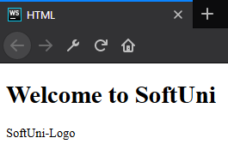
Images
<body> <h1>Welcome to SoftUni</h1> <img src="softuni-logo.png" alt="SoftUni-Logo"/> </body>
<body> <h1>Welcome to SoftUni</h1> <img src="softuni-logo.png" alt="SoftUni-Logo"/> </body>

Slide 33
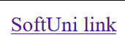
Links / References
They are the essence of the Web
To add a reference, we use this simple element <a>, as it comes from anchor
It needs an attribute to hold the reference we want to make.
This attribute is called href from hypertext reference
<body> <a href="https://softuni.bg">SoftUni link</a> </body>

Slide 34

Forms
Forms are one of the main points of interaction between a user and a web site or application
An HTML Form contains form elements. Those elements can be text fields (single line or multiline), select boxes, buttons, checkboxes, or radio buttons

Slide 35
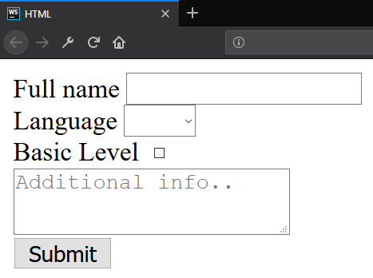
Forms
<form>
<label for="fullName">Full name</label>
<input id="fullName" type="text" name="fullName"/><br>
<label for="language">Language</label>
<select id="language">
// TODO: Add <option> tags
</select><br>
<label for="knowledge">Basic Level</label>
<input id="knowledge" type="checkbox" name="language" value="yes"><br>
<button type="submit">Submit</button></form>

Slide 36

Multimedia Context

Slide 37
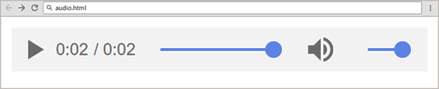
Embedding Audio
The <audio> element inserts audio player in the Web page
Audio will play automatically
<audio controls autoplay>
<source src="horse.mp3" type="audio/mpeg">
Your browser does not support the audio tag.
</audio>
Audio file name
Audio file format
Alternative text

Slide 38



Embedding Audio
Audio formats supported:
MP3 - audio/mpeg
OGG - audio/ogg
WAV - audio/wav
Attributes:
controls
autoplay, loop, preload

Slide 39
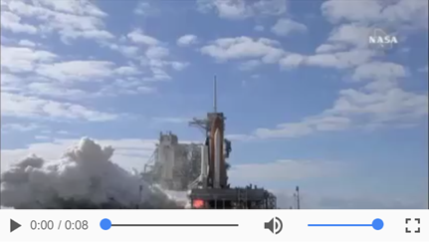
Embedding Video
The <video> element inserts video player in your site
<video controls="controls">
<source src="shuttle.mp4" type="video/mp4"> Your browser does not support the HTML5 video.
</video>
Video file name
Audio file format
Alternative text

Slide 40

Embedding Video
Video formats supported:
MP4 - video/mp4
Ogg - video/ogg
WebM - video/webm
Attributes:
width, height
poster
controls
autoplay, loop

Slide 41
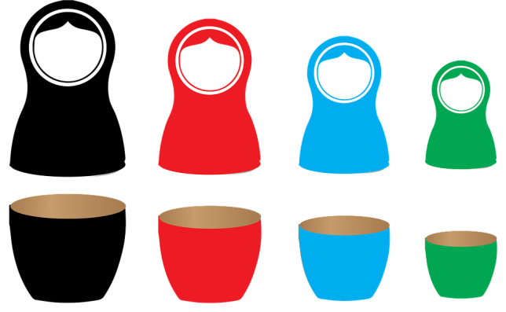
Nested Elements

Slide 42


Nested Elements
It is possible to put an element inside another element - this is called nesting
Elements need to be opened and closed properly to be truly inside or outside of each other
Some items have no content and are called empty elements

Slide 43
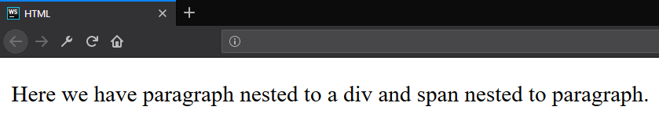
Nested Elements - Example
<div> <p>Here we have paragraph nested to a div and <span>span nested to paragraph</span>.</p> </div>

Slide 44
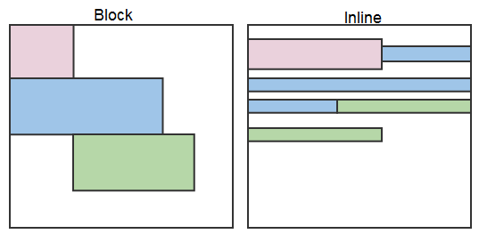
Display properties – block and inline
Browsers treat every element as a kind of box
There are two types of boxes
Block
Inline

Slide 45
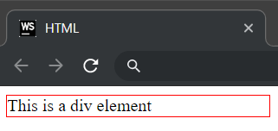
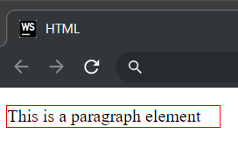
Block elements
Always starts on a new line
Fills up the horizontal space left and right on the web page
Block elements are <div> and <p>
<div>This is a div element</div>
<p>This is a paragraph element</p>

Slide 46
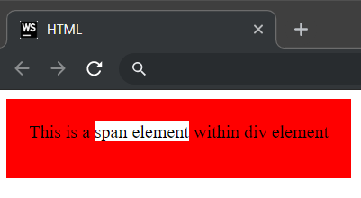
Inline elements
Appear on the same line as the content and tags beside them
Inline elements can appear within block elements
Inline elements are <span>, <strong>, <img>
<div>This is a <span>span element</span> within a div element</div>

Slide 47

Summary
What is HTML?
Element anatomy
Document anatomy
Formatting text
Attributes
Images, Links and Forms
Multimedia context
Nested Elements
…
…
…

Slide 48
https://softuni.bg/trainings/courses

Slide 49












SoftUni Diamond Partners

Slide 50




SoftUni Organizational Partners

Slide 51




Trainings @ Software University (SoftUni)
Software University - High-Quality Education and Employment Opportunities
softuni.bg
Software University Foundation
http://softuni.foundation/
Software University @ Facebook
facebook.com/SoftwareUniversity
Software University Forums
forum.softuni.bg

Slide 52

License
This course (slides, examples, demos, videos, homework, etc.) is licensed under the "Creative Commons Attribution-NonCommercial-ShareAlike 4.0 International" license

